Slide 1


Using Network Analysis to Investigate U.S. Influence on Poland’s Round Table Process
Kelly Bodwin, Associate Professor of Statistics, California Polytechnic State University, San Luis Obispo
Greg Domber, Senior U.S. Fulbright Scholar (ISPPAN and Instytut Amerikanystyki UJ) 2022-2023
Notes:
Dziękuję bardzo za obecność. Jestem bardzo podekscytowany, że mogę podzielić się z Tobą naszymi badaniami. Niestety ja tylko słabo mówię po polsku a Kelly nie mówi nic. A więc, . . .
Thank you to the Institute for hosting me these past months
Today, I want to accomplish three key tasks:
To introduce to you a relational dataset focused on the participants in the Polish Round Table process and a purpose-built network analysis tool that allows us and any interested scholars to visualize the shifting connections between these individuals over the course of the Cold War, from the 1940s to 1989. World premier. .. We'll be providing a link to instructions on how to actual utilize both the dataset and the connected R Shiny App for visualization and analysis.
I will spend some time explaining how I am using this network analysis tool for my own research interests focused on the effects of U.S. exchange programs on the RT table process. I will provide some context and some early insights from the network analysis about the roles of Poles who participated in the RT negotiations and who went to the U.S. on exchange programs from 1956 to 1989.
Most broadly I want to explain the digital humanities methodology that we are using here. This will highlight the ways that this app can be used to further historical research on any number of topics related to the individuals in the network analysis tool we are introducing today.
We want to leave time for your questions and comments and to hopefully begin a conversation with those of you who might be interested in using the visualization tool.

Slide 2
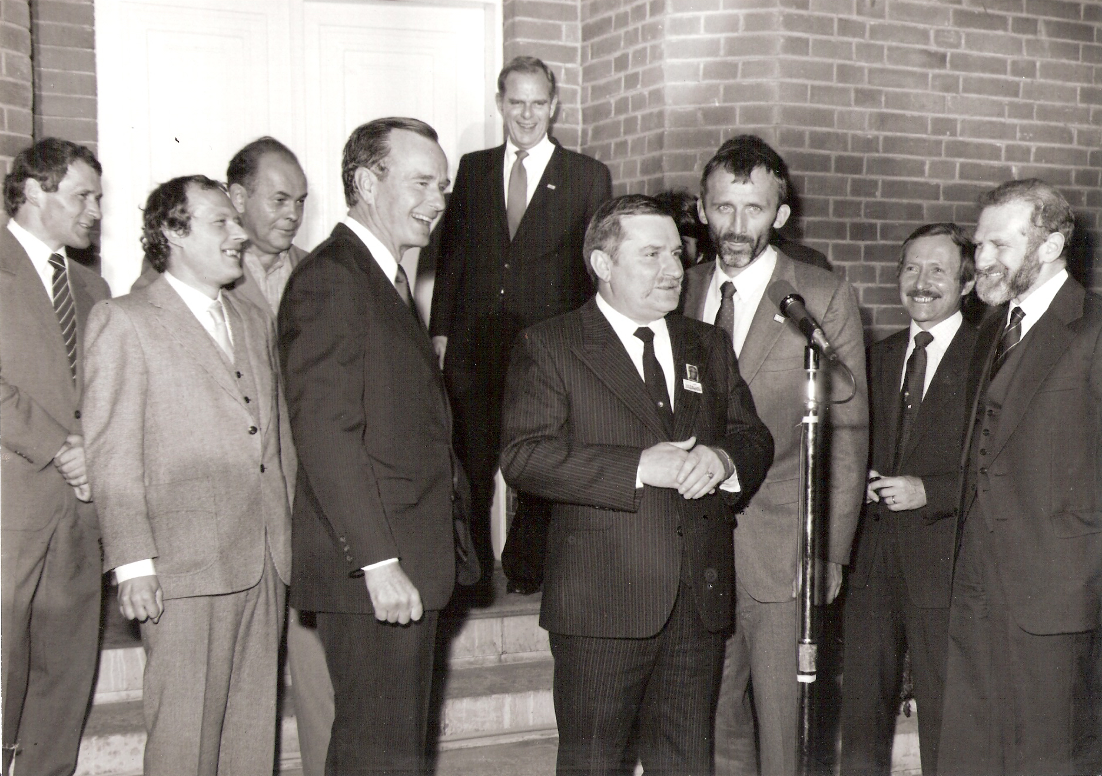
CORE Research Question:
Did East-West exchanges shape or influence Poland’s political transformation in 1989? If so, how?
Notes:
My first book was on U.S. influences on Poland’s transformation to democracy in the 1980s, culminating in 1989 with the Round Table process, where groups of Communist government officials on one side of a table talked with opposition officials on another side of the table to create a power-sharing agreement that set the path toward full democracy shortly thereafter. Creating the conditions for this kind of peaceful transfer of power has fascinated me to no end.
One of the truths that struck me while I was working on American influences in Poland in the 1980s, was that by the 1980s American diplomats had longstanding relationships with key figures in both the reform groups within Communist circles and within the opposition. At one point in one of my interviews with John R. Davis, Jr., who was the American ambassador to Poland throughout the 1980s, he said something like, “By the time we got to the round table the embassy knew most people on both sides of the table through the Fulbright exchanges and other activities.”
It was out of this insight or curiosity and regular anecdotes I had heard about important members of both the opposition side and government side of the round table having spent time in the West, that I first came up with the broad research question that launched this project: [READ FROM SLIDE]
In a bigger scope, the question I am asking here is: is there some way to map and analyze exogenous influences on domestic epistemic communities?
And while there was plenty of scholarship that has broached the topic of the effects of exchanges or public diplomacy with Eastern Europe, that scholarship tended to be anecdotal. From the beginning I wanted this to be a project that mixes qualitative and quantitative methodologies. Network analysis provided the tools for using quantitative techniques to investigate my research question. That is why, I then sought out Kelly.
I began this research project to test out a specific hypothesis that United States' exchange programs helped to promote moderation within Poland's political transformation in 1989, basically that participants in East-West exchanges played an intermediary role between the government and the opposition at those negotiations.

Slide 3
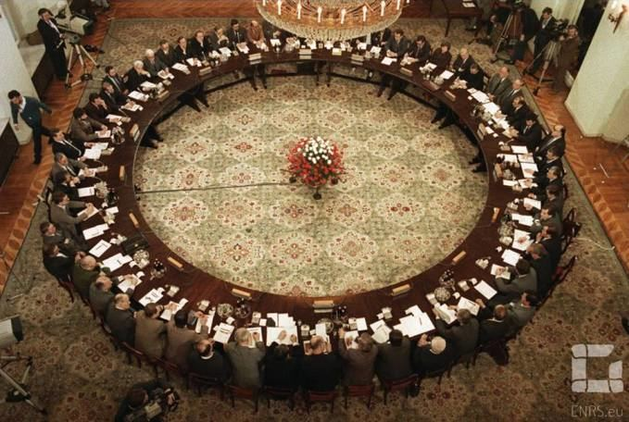
Network for analysis: Individuals who participated in the Round Table
567 individuals
Government, Opposition, Experts, Church, and Observer
Plenary Session and multiple sub-groupings and working groups
Created a network visualization app using Shiny (R package)
Notes:
The first choice I had to make was to choose the group of individuals I wanted to analyze, and I chose the 567 participants who took part in the Round Table negotiations. I have always been most interested in the elites who took part in the democratic transformation so this group seemed a natural fit for my interests.
Explain who this includes based on slide.

Slide 4
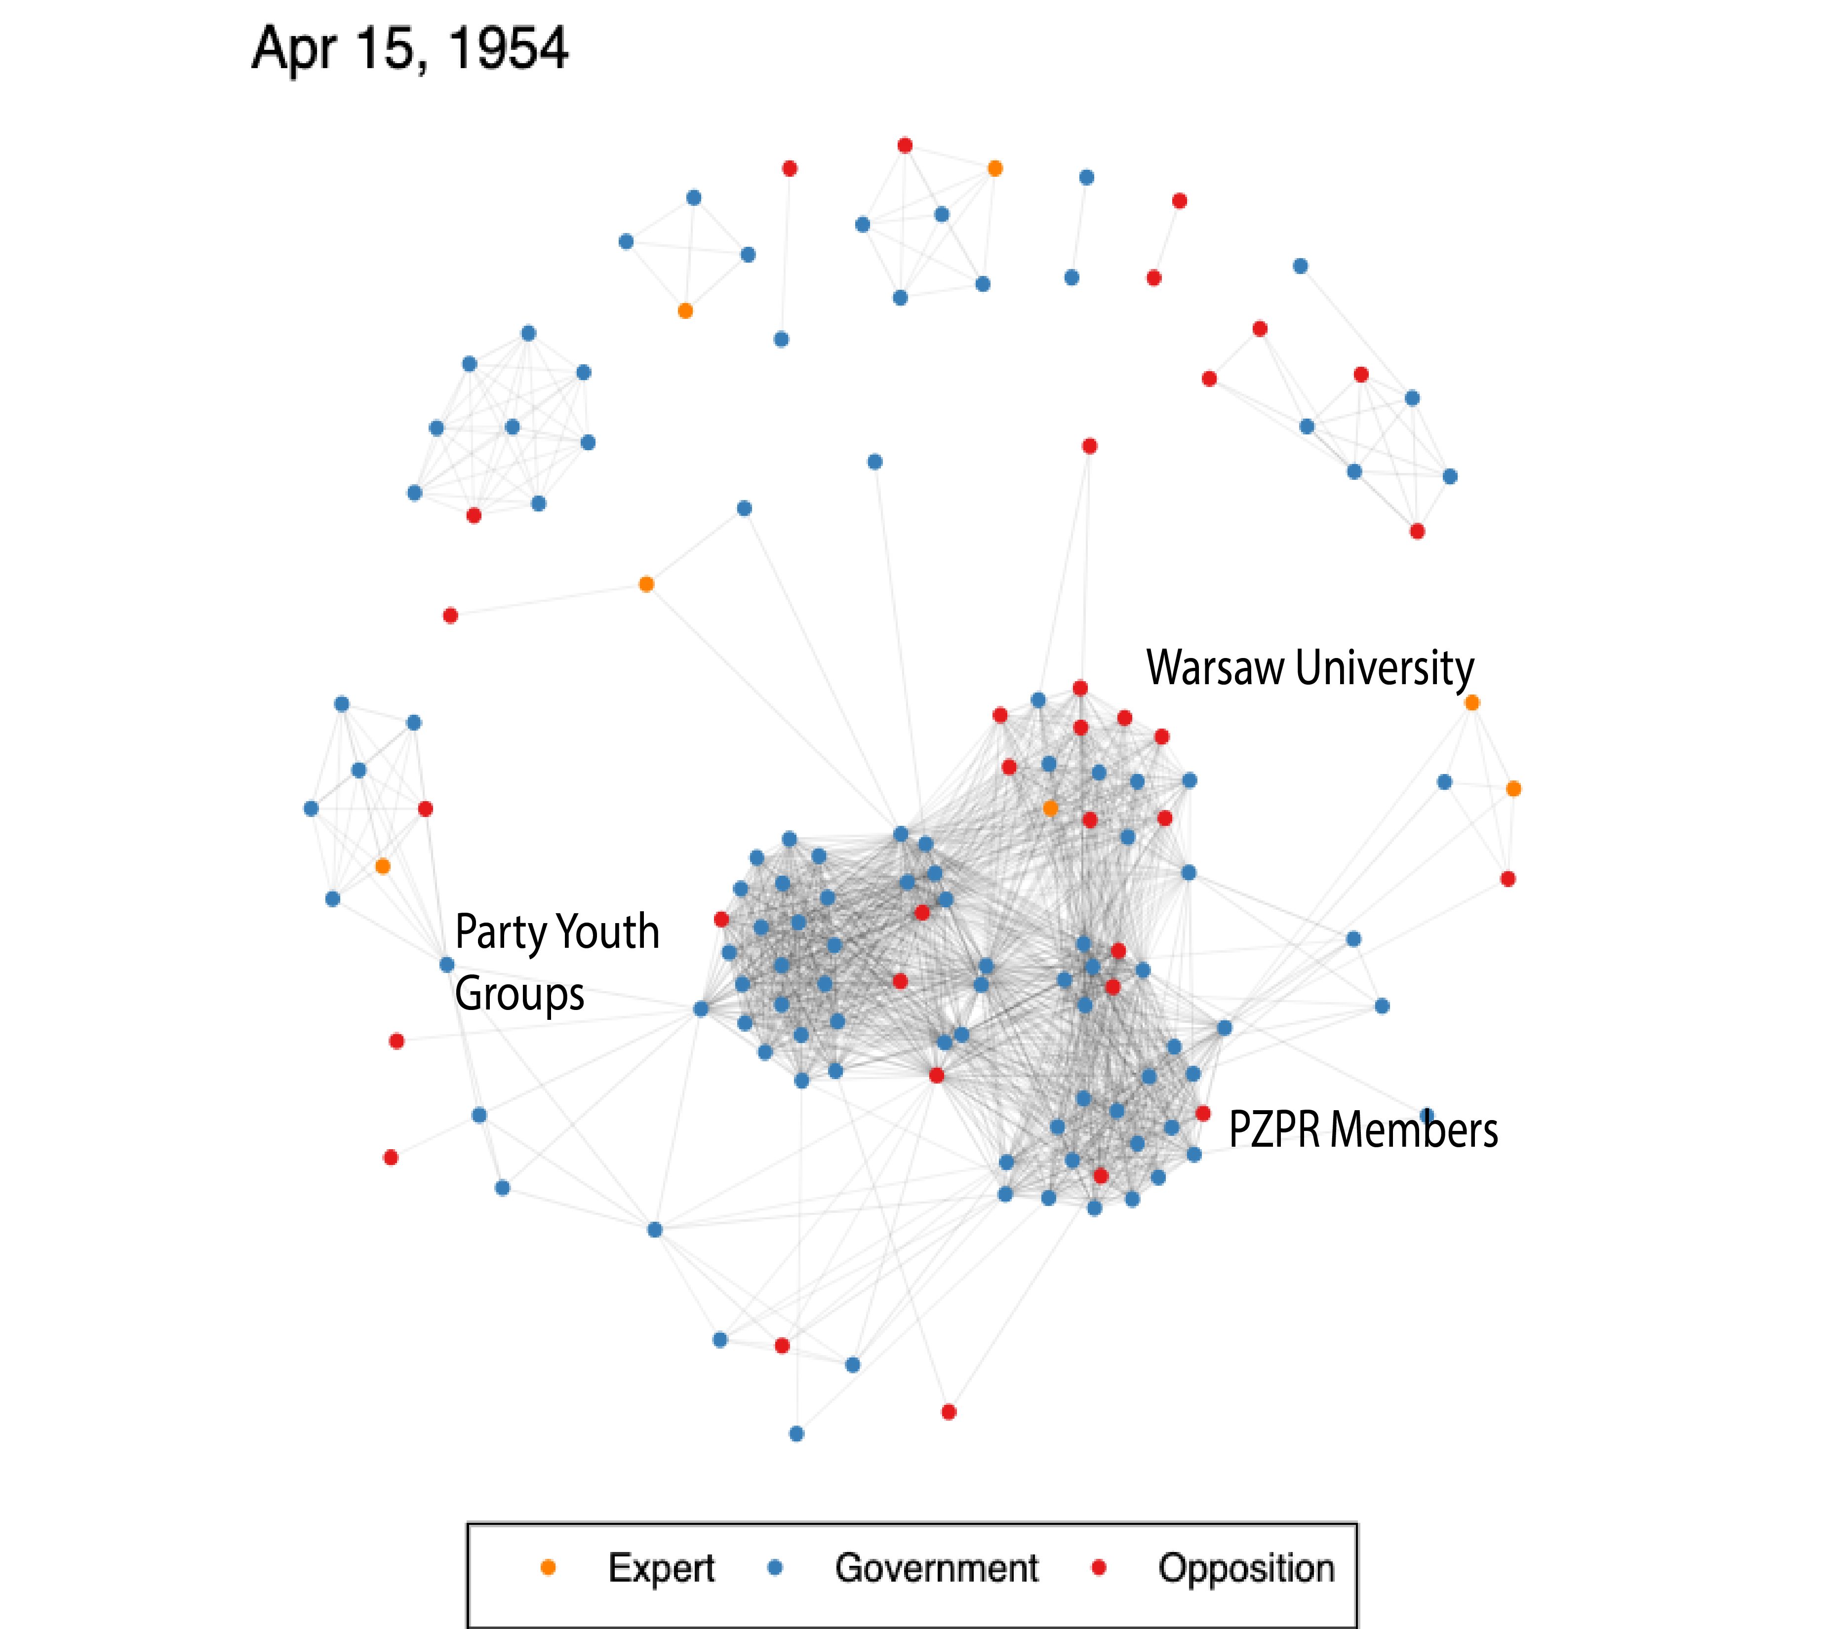
Notes:
Mostly interested in the post-war period, and this is a network visualization from April 1954.
Dots = nodes = individual people
Lines = edges = connections at that point in time
Three clear clusters in 1954
Youth groups are a function of the ages of RT participants in 1989
PZPR membership expected, Warsaw University surprise a bit: function of the importance of this university to elite formation
Lots of intermingling between what will be opposition and government

Slide 5
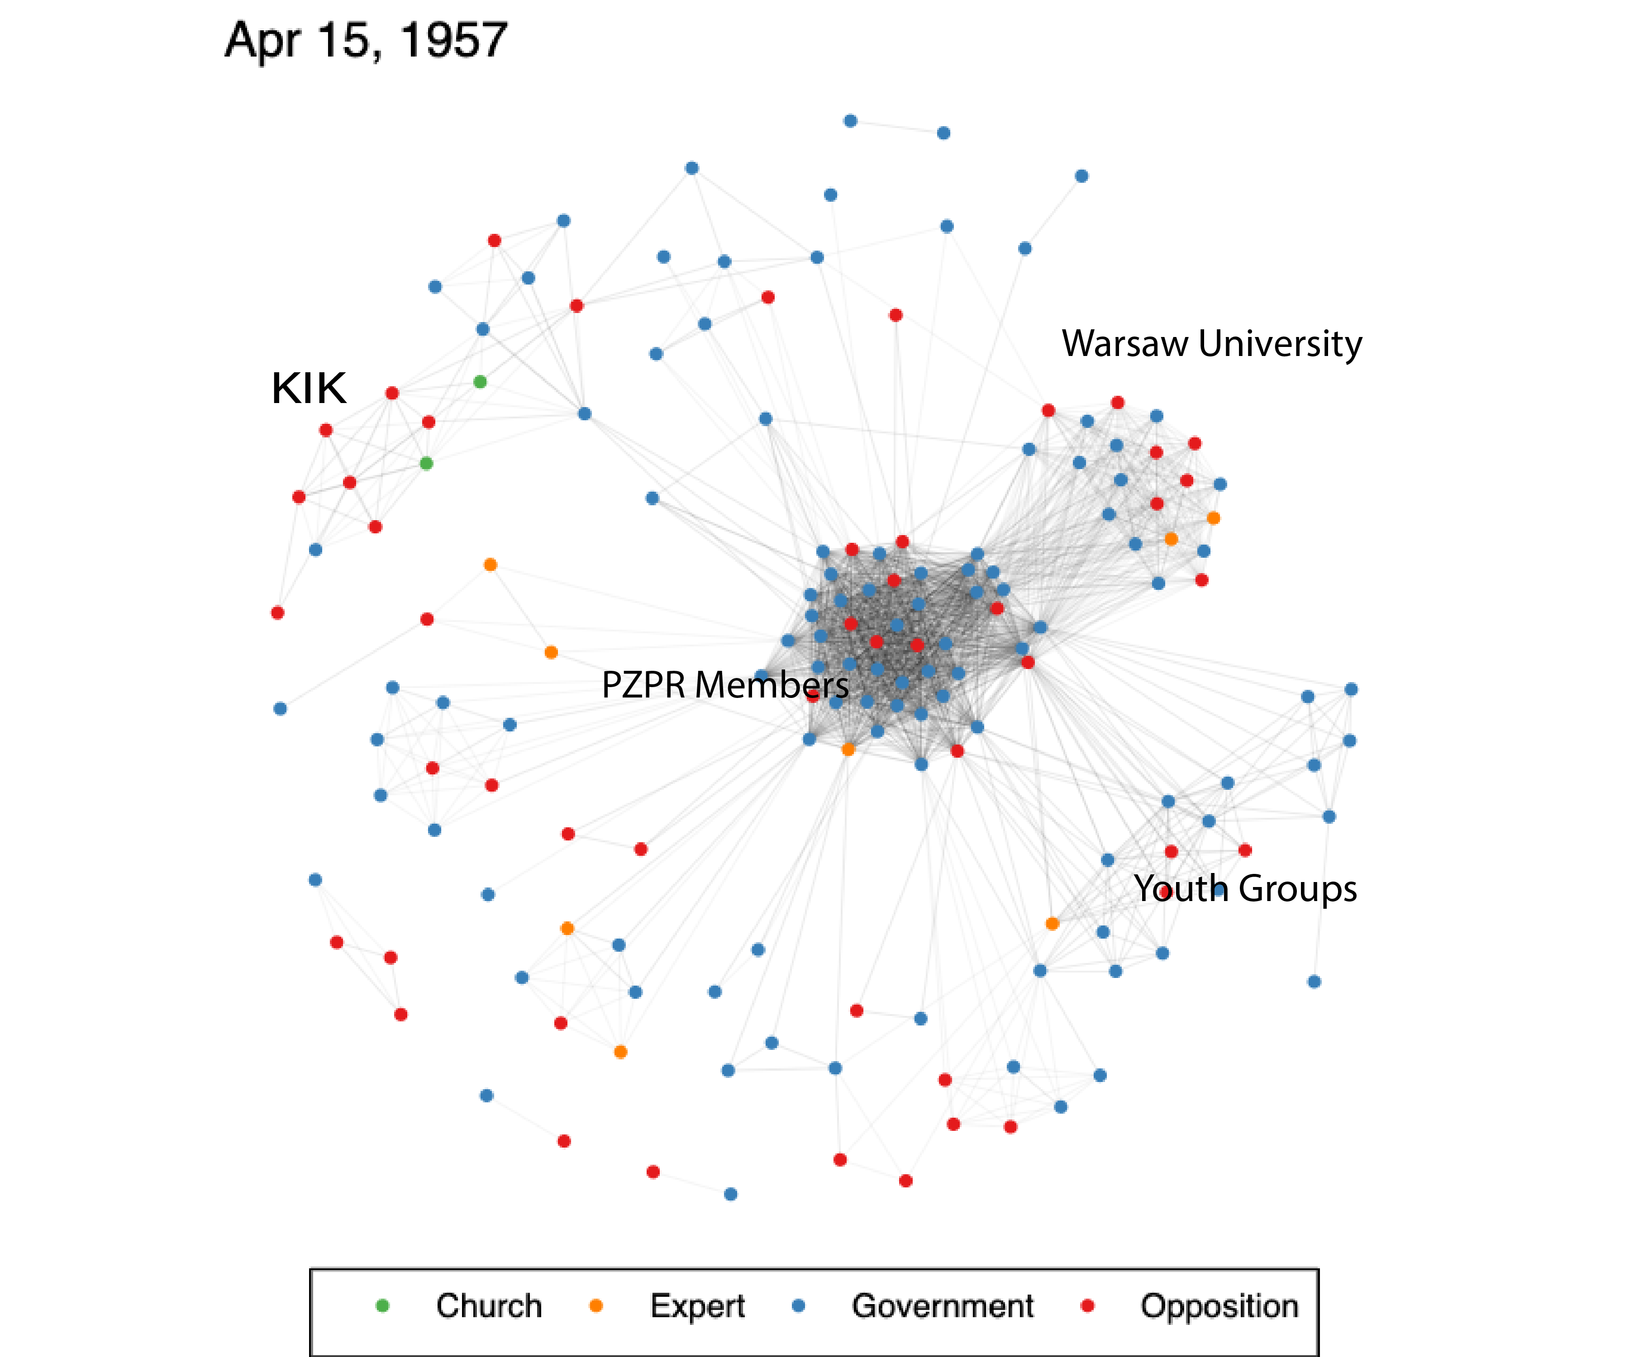
Notes:
By 1957:
PZPR retains primacy, members of youth groups less numerous, UW still important
KIK and Catholic circles in Krakow, Warsaw, and Lublin exist, but do not fundamentally reshape the network.

Slide 6
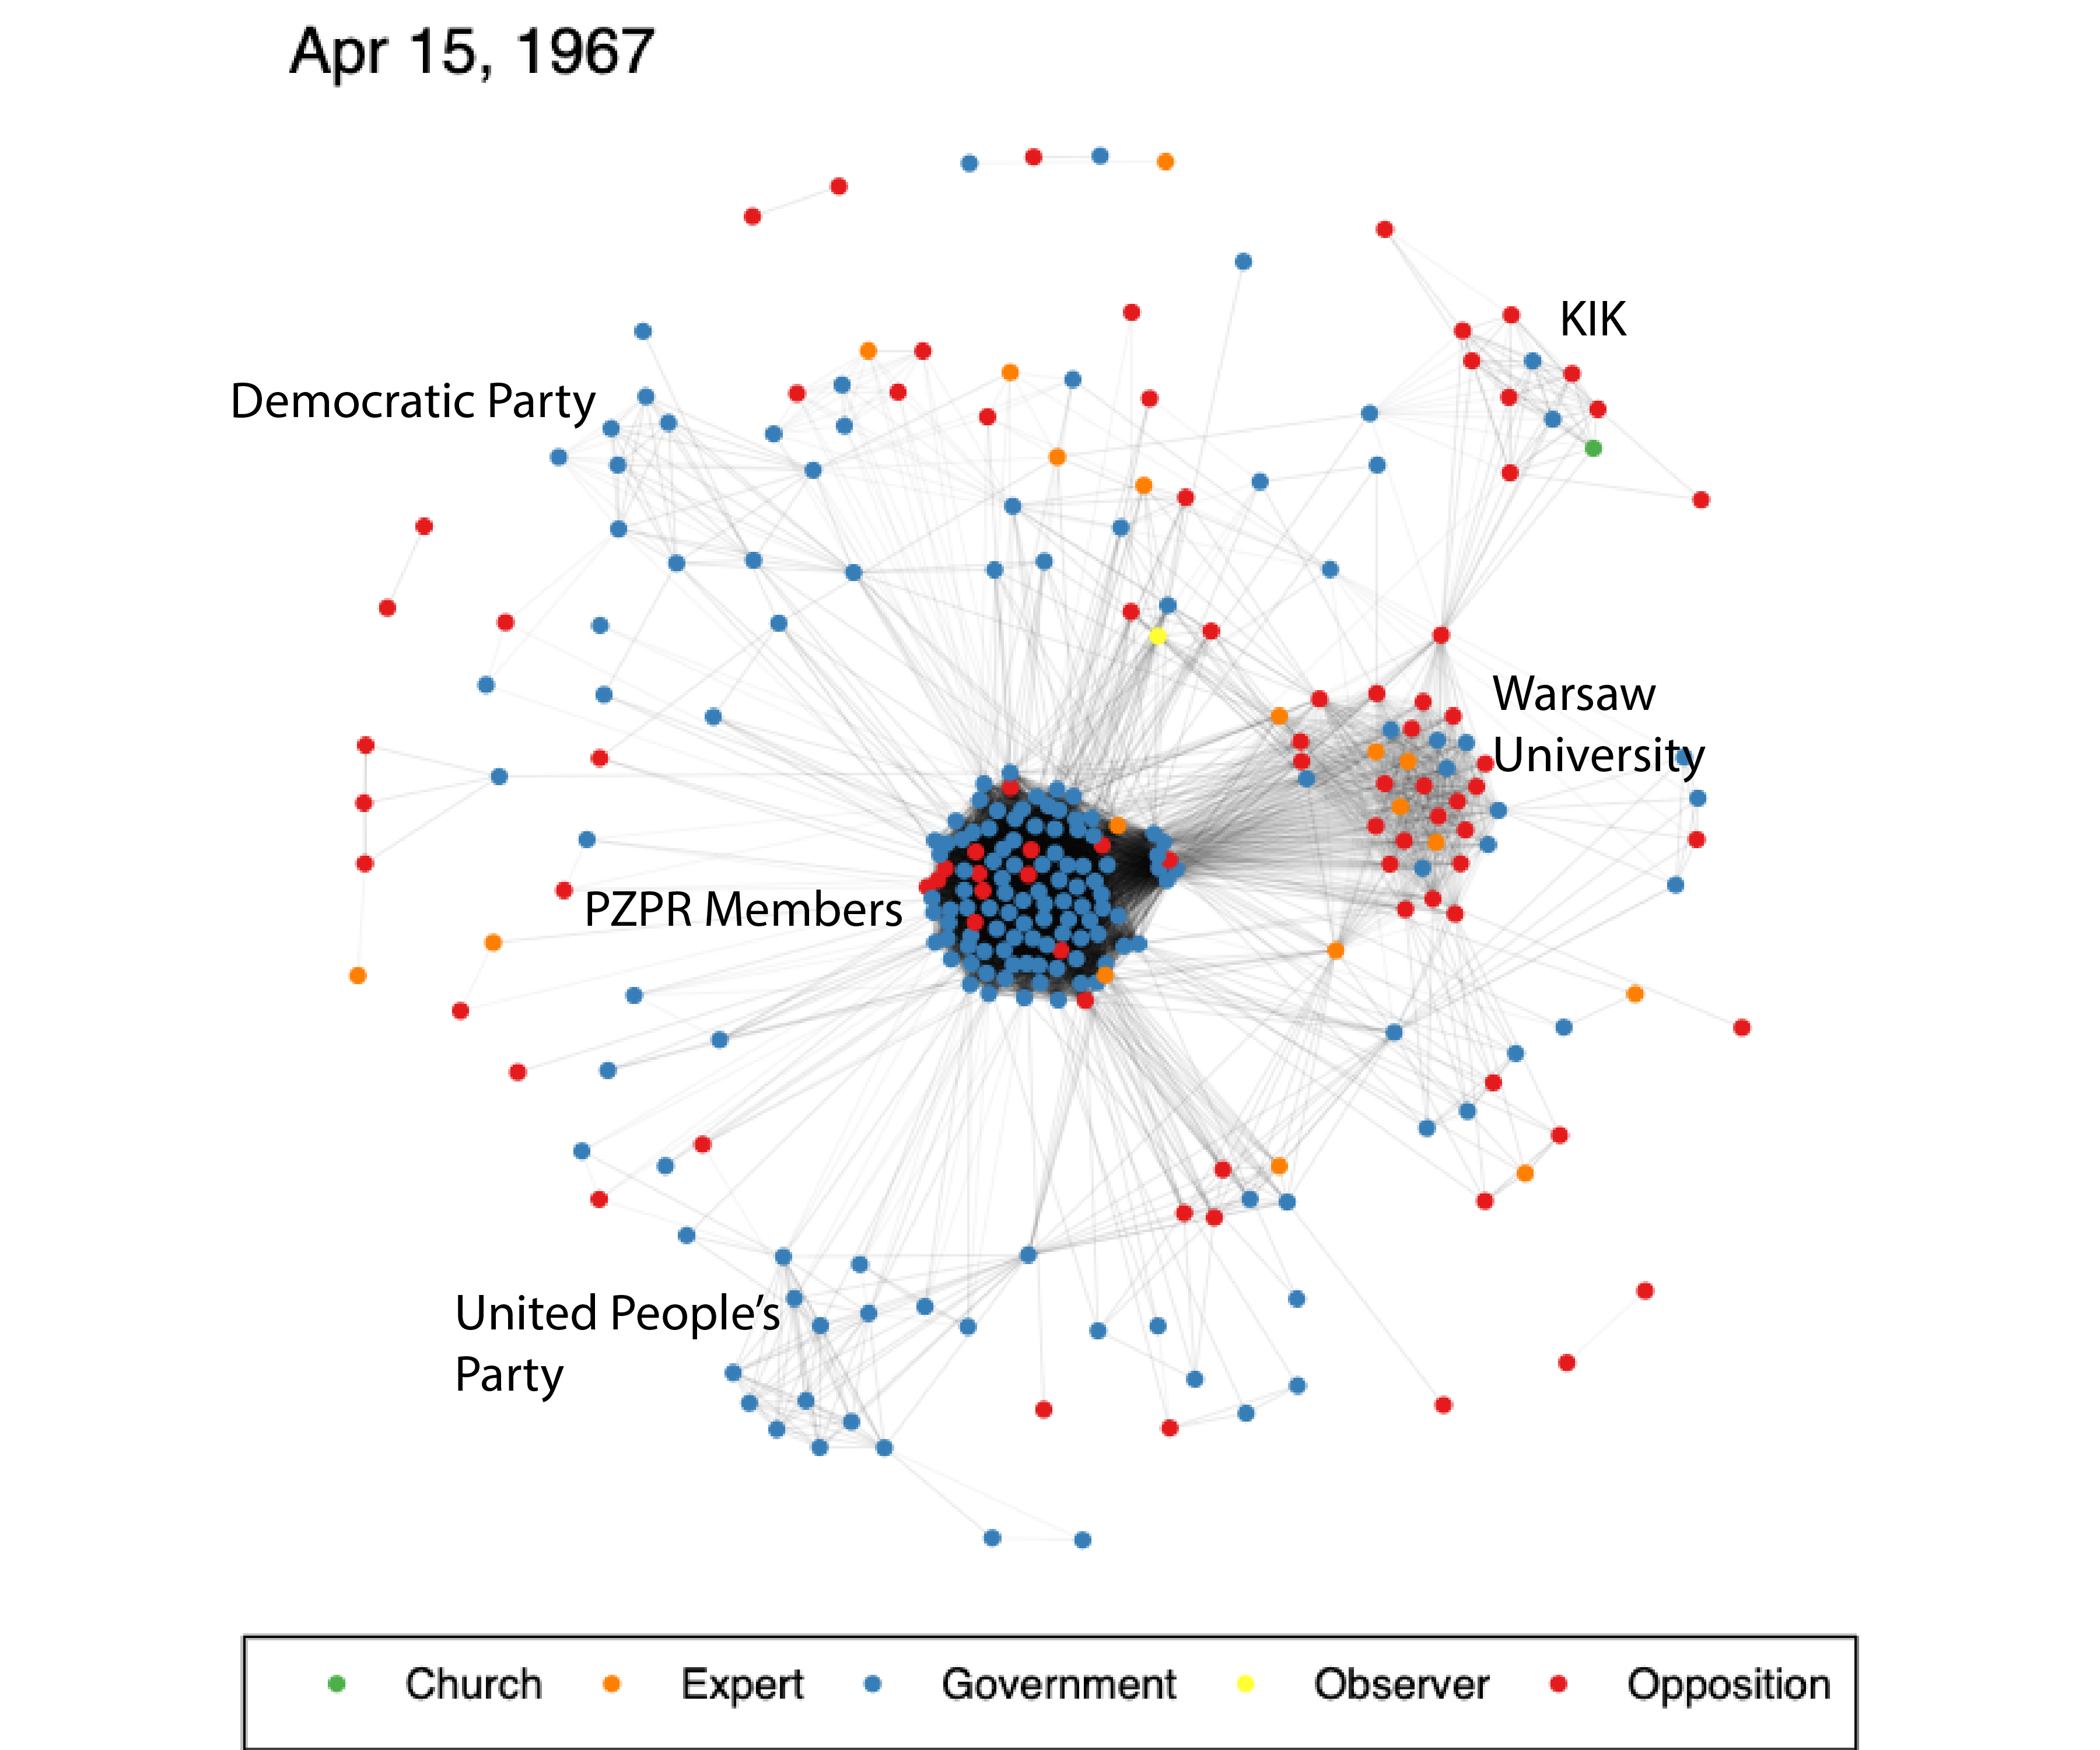
Notes:
Not much changes over the courses of the 1960s, but interesting that KIK is now connected to Warsaw University.

Slide 7
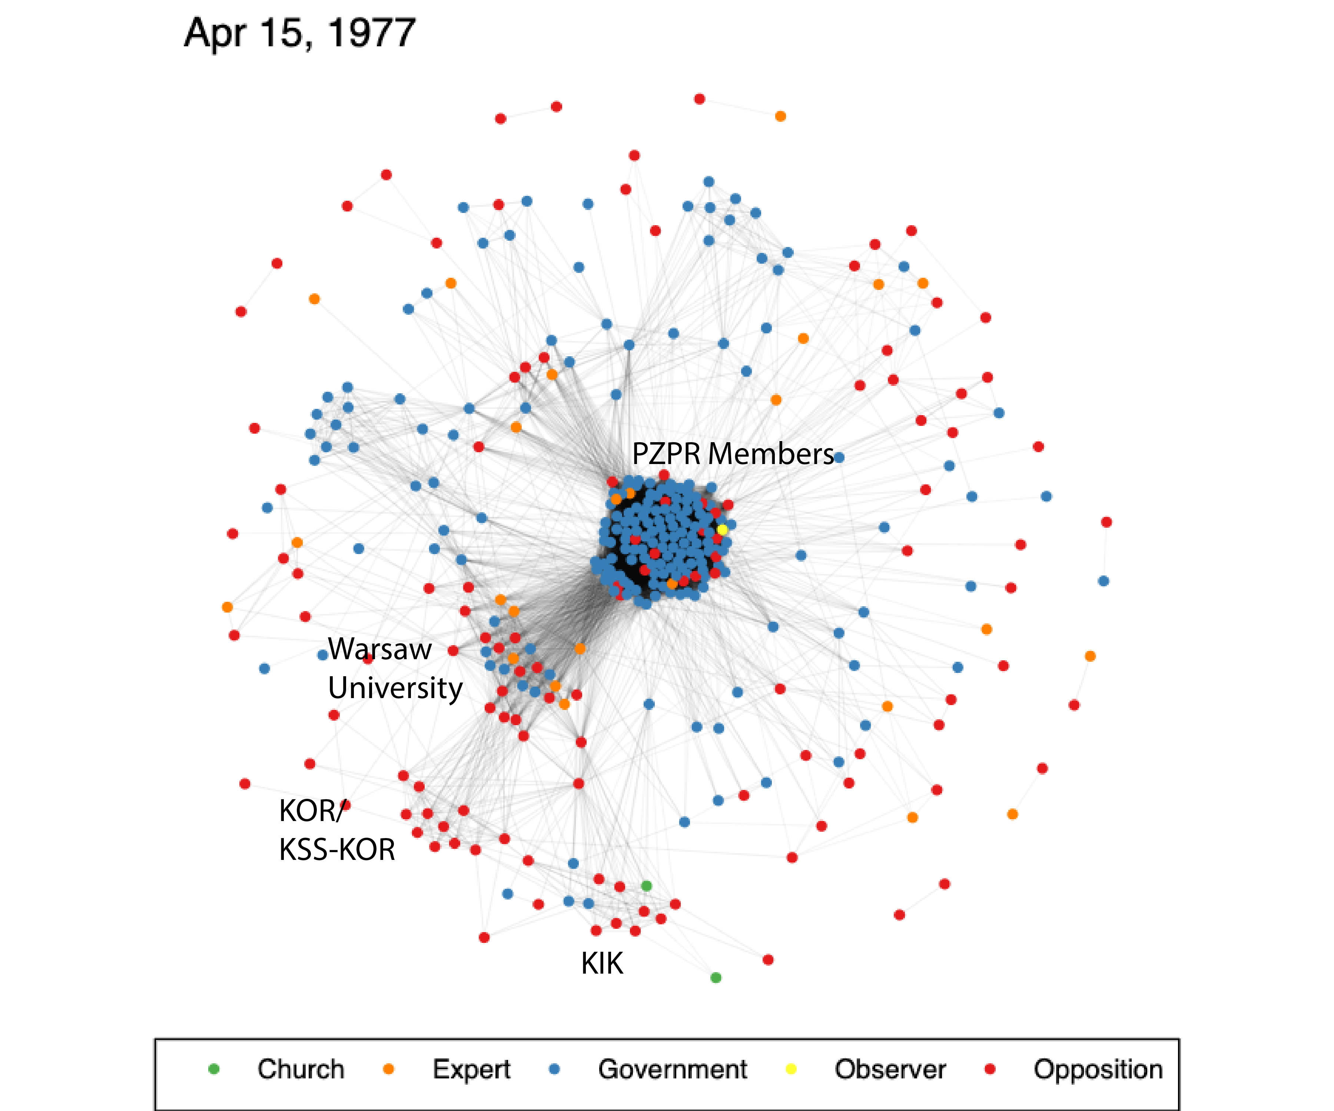
Notes:
After June 1976 strikes, creation of KOR begins to disrupt the prevailing patterns, connecting with KIK to create a growing center of opposition.

Slide 8
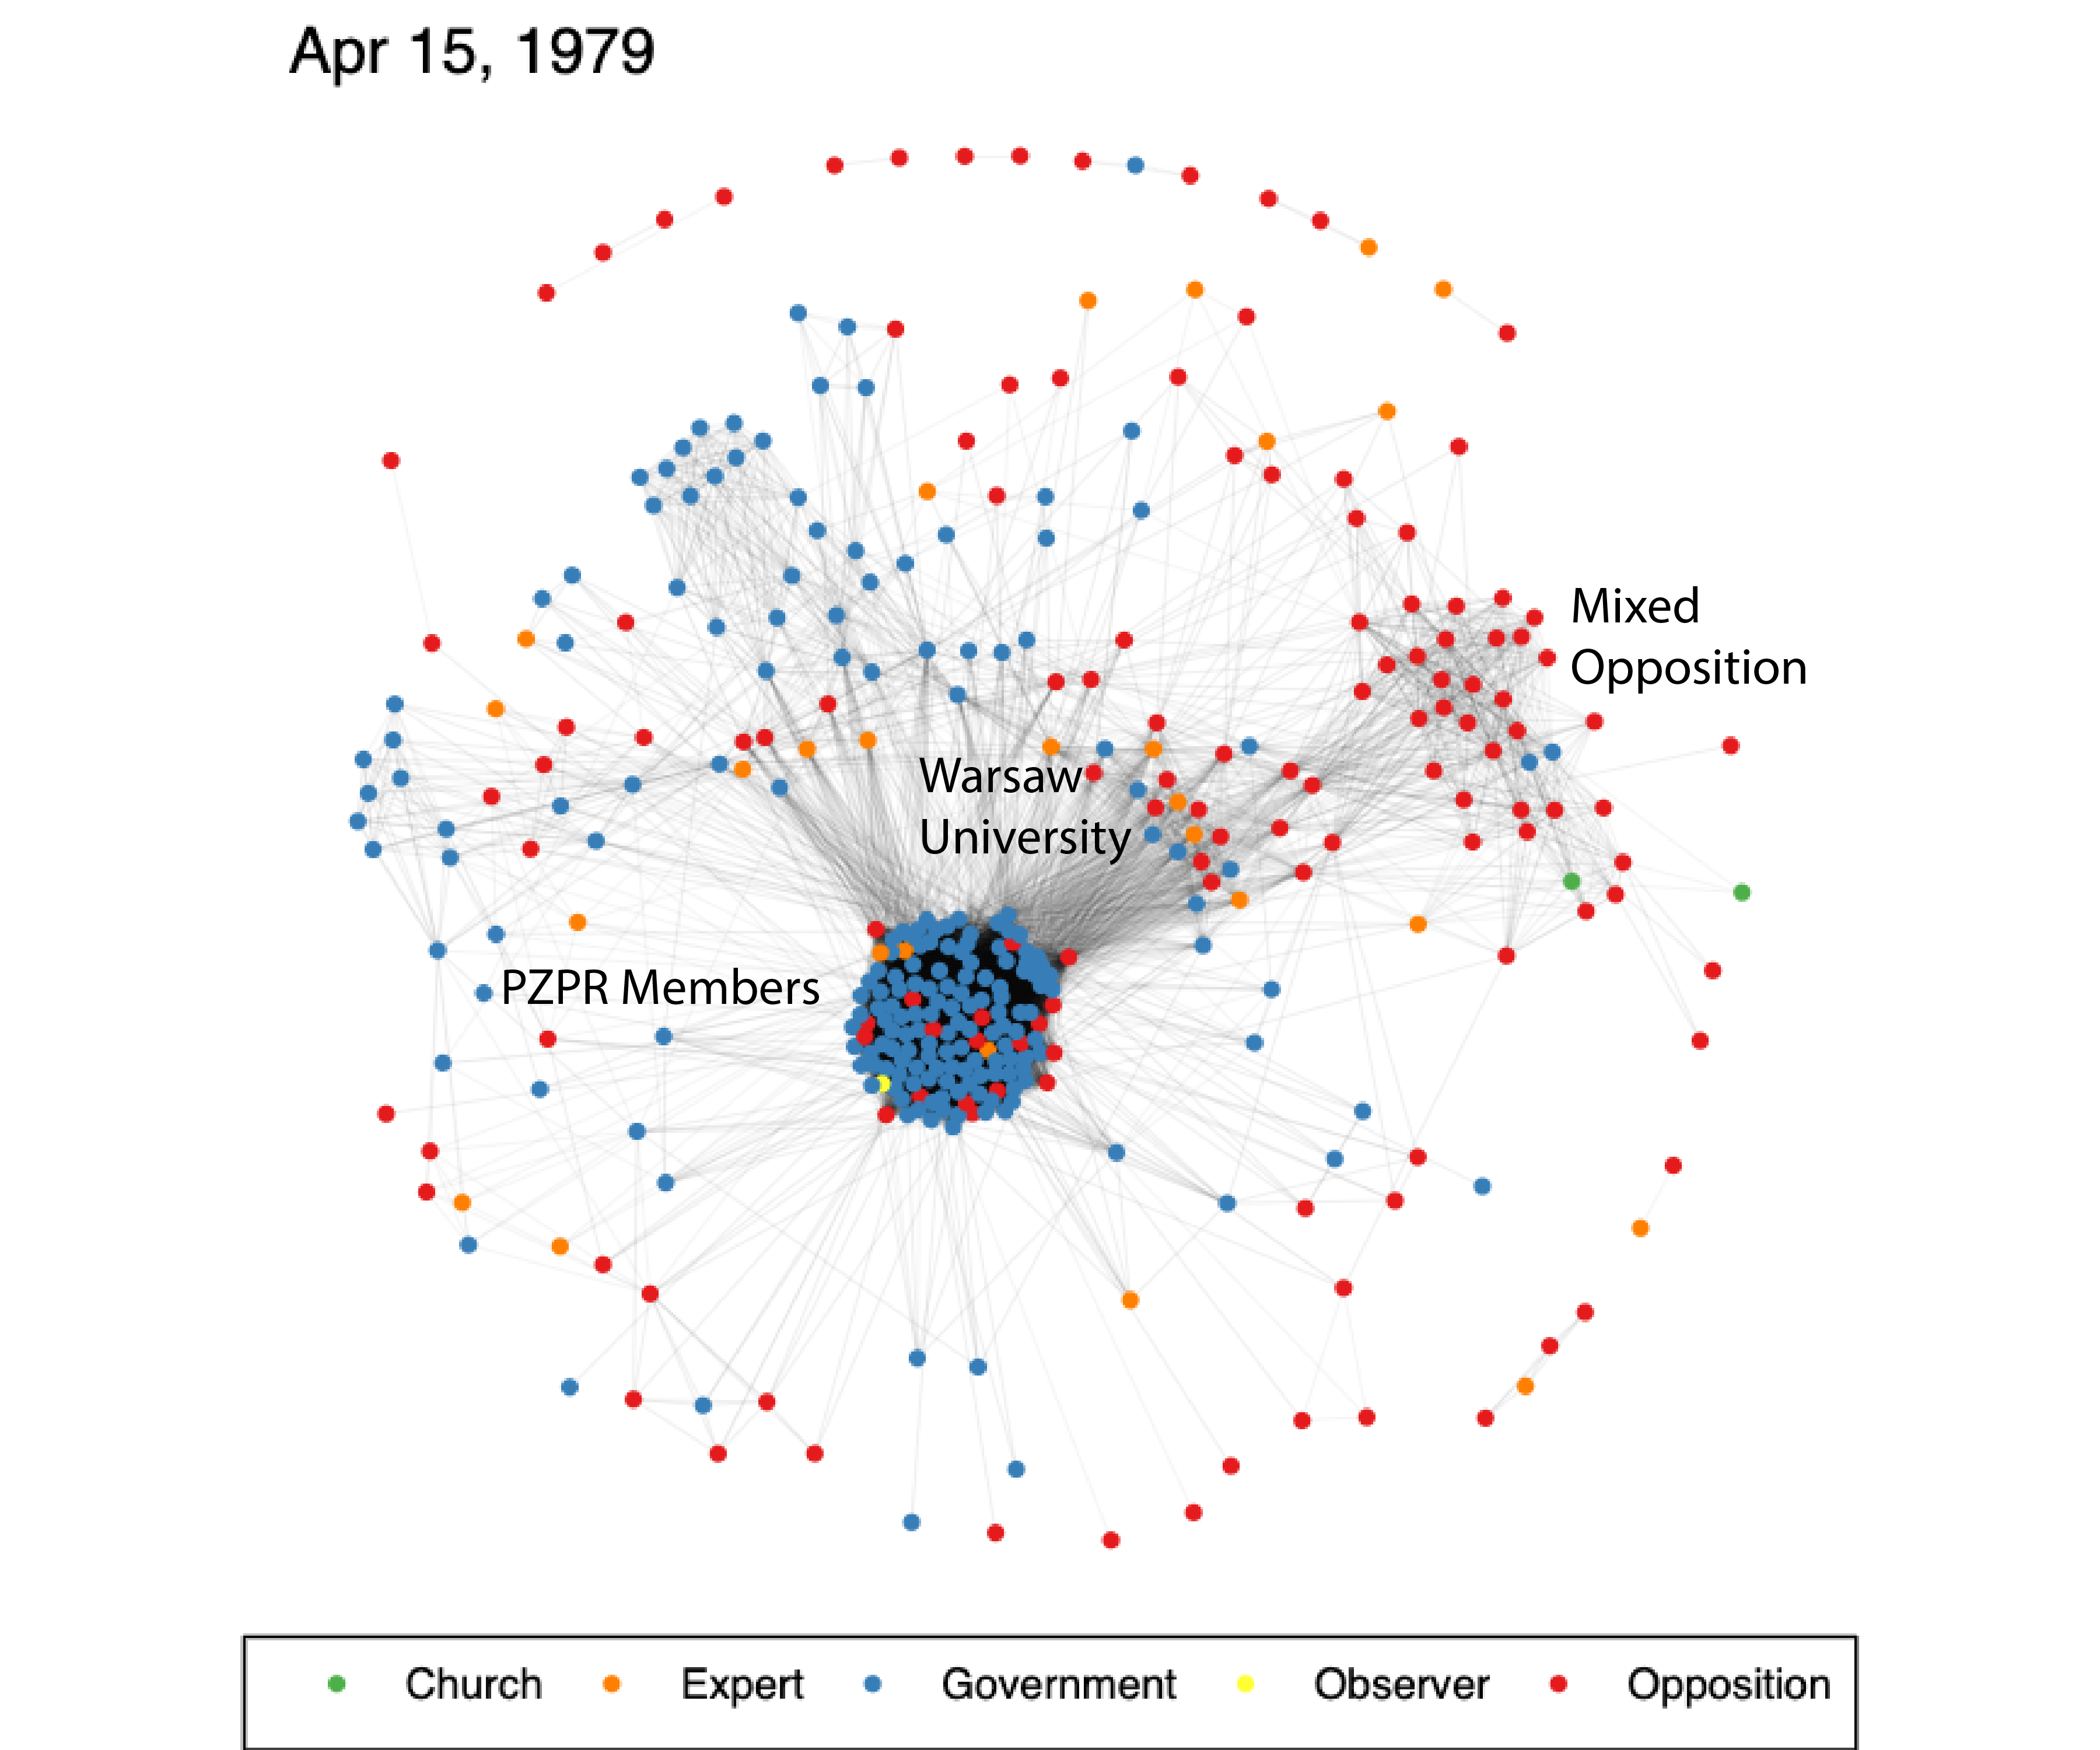
Notes:
By 1979, there is now a clear zone of opposition, primarily with KSS-KOR, samizdat, and other groups, disrupting the Warsaw University cluster. Almost appears to be pulling UW into the opposition.

Slide 9
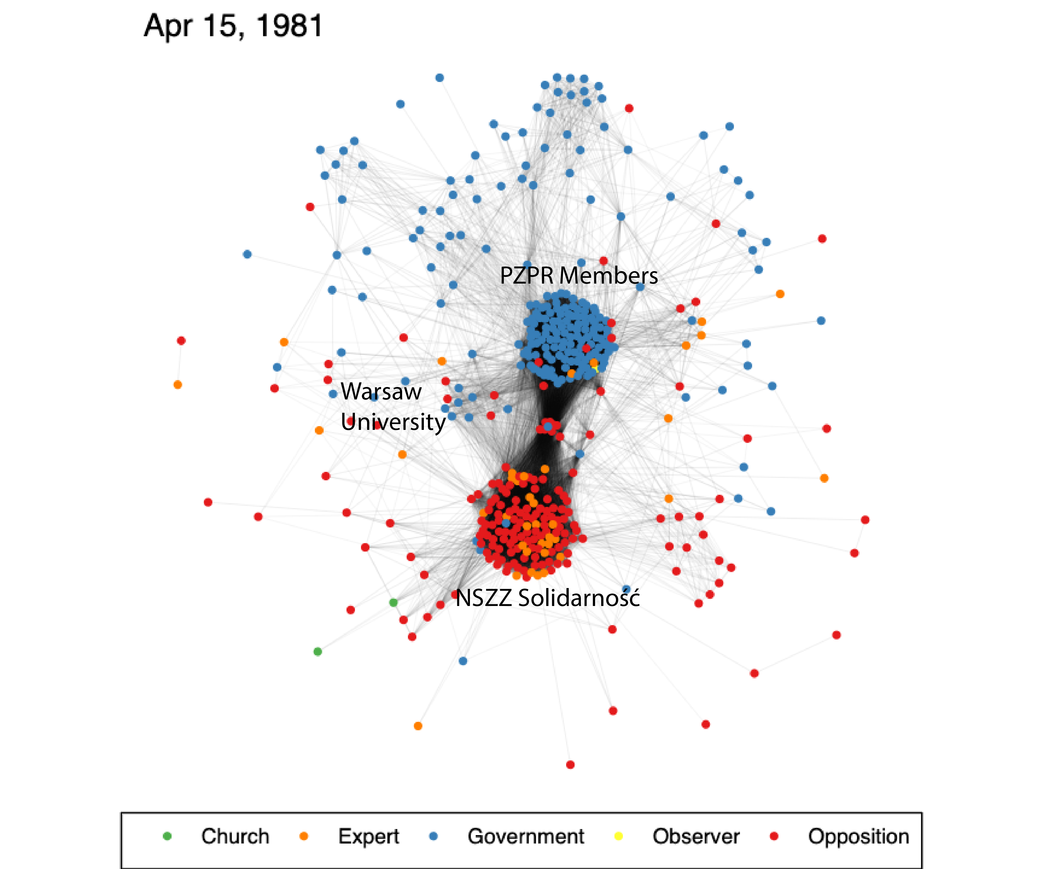
Notes:
Totally new pattern after the creation of Solidarnosc: two clear, opposing clusters. This is clearly a revolutionary turn. Brings members of the opposition much closer together in a clearly coherent sub-network. Comparable cohesion to PZPR. Warsaw University individuals (smaller number) do have a roll between the two clusters.

Slide 10
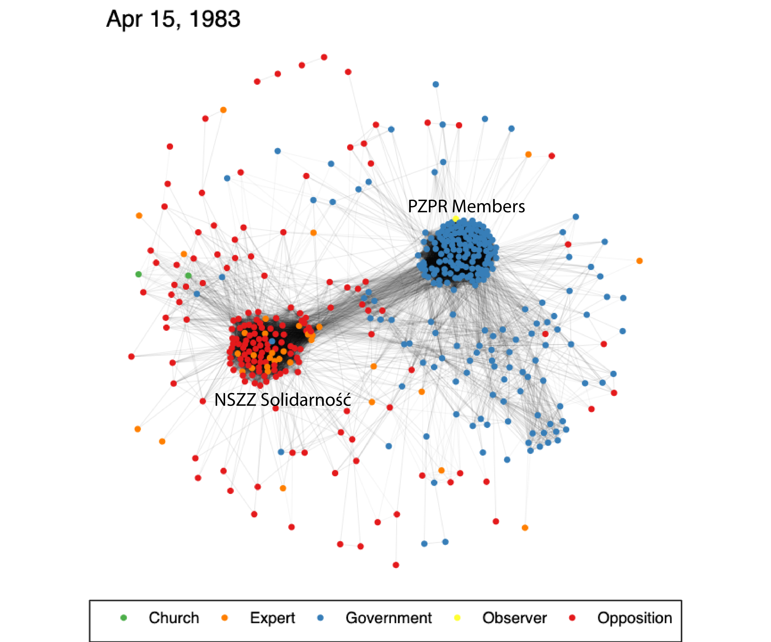
Notes:
After the declaration of martial law, PZPR and NSZZ Solidarnosc are a further distance from one another.

Slide 11
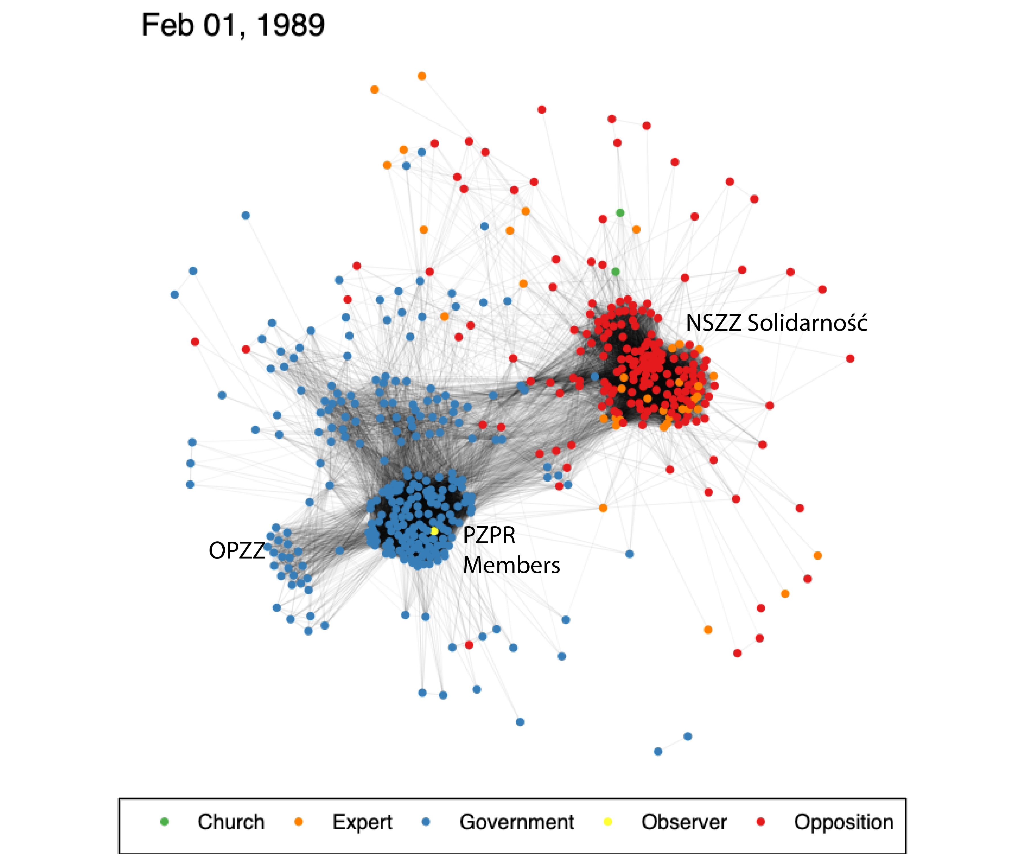
Notes:
By February 1989, you have two clear zones of opposition and government, but with some very interesting structures:
OPZZ far away from NSZZ, KZRKiOR the same
different groups within the opposition cluster
the cloud of government groups, PRON, SEJM, Council of Ministers

Slide 12
Round Table Participants Dataset creation
Notes:
Go through the participants dataset for Wladyslaw Sila Nowicki, also look at how organizations were classified and ordered.
Umbrella versus smaller groups. Each group does not necessarily have more than one member at any time.
Now turn it over to Kelly to explain how she processed this information and created the Shiny application to actually create the visualizations.

Slide 13

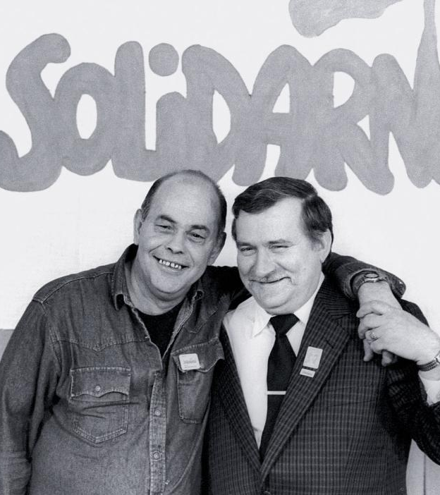

How to Quantify a Life?
Institutional Affiliations
Places of work
Educational history
Connection to publishers and publications/samizdat
Party and government positions
Opposition and independent society positions
Events (strikes, negotiations, open letters, etc.)
Notes:
So, how did we create this network analysis? First, needed to gather data about each of the participants in the RT. Talk about the concept of institutional affiliations. Unlike personal connections/friendships IAs can be historically recreated for a large group of people. Then break from the slideshow to show the actual database entry on Wladyslaw Sila-Nowicki.

Slide 14
Database Source Notes
Opposition Affiliated
Government
Okrągły stół . Kto jest kim opozycja (1989)
Encyclopedia Solidarności (ESC and IPN)
Kto jest Kim w Polsce (1989 and 1993)
Opozycja w Polsce. Slownik Biograficzny 1956-1989
Internet searches
Mołdawa, Ludzie Władza 1944-1991
Kto jest Kim w Polsce (1989 and 1993)
AAN PZPR CC Centralna Kartoteka
IPN Biuletyn Informacji Publicznej
Internet Searches
Notes:
Give some stats on the work that was created.

Slide 15
Round Table Participants DATABASE and shiny app DESIGN
Notes:
Go through the participants dataset for Wladyslaw Sila Nowicki, also look at how organizations were classified and ordered.
Umbrella versus smaller groups. Each group does not necessarily have more than one member at any time.
Now turn it over to Kelly to explain how she processed this information and created the Shiny application to actually create the visualizations.

Slide 16
Data Cleaning
Convert to long format:
Each row is one affiliation of one person
Separate dataset for demographic info about people
Separate dataset for additional info about organisations
Reconciling different spellings of names and organizations
Alternate names: "Faculty of Math" vs "Math Faculty"
Polish names vs. English names
Each person and each organization has a unique ID number

Slide 17
Shiny App Design
Major R packages used:
ggplot for basic visuals
ggiraph and plotly for hover popups and click selection
igraph for creating network layouts and computing metrics
Network algorithms:
Fruchterman-Reingold layout algorithm, by default
Betweenness centrality: computed by shortest paths

Slide 18
Shiny App Design
Efficiency of filtering to desired date range, organizations, and individuals
Computing edge weights in different ways
Efficiency and aesthetics of node location algorithms
Over 1000 lines of code!

Slide 19
Accessing the resources
Datasets: Google Sheet
Shiny App:
Install the polarexpress package from GitHub
Run function run_network_app()
All links and instructions:
www.kelly-bodwin.com/projects/polish_networks/info-page

Slide 20
App Usage Tips
Generating visuals:
Make all choices then click the action button
Refresh app to reset highlighted nodes
Don't forget the "download png" option!
Edge definition choices:
Large organizations will influence the network more
Do you want extra edge weight for "Umbrella groups"?

Slide 21
CORE Research Question:
Did East-West exchanges shape or influence Poland’s political transformation in 1989? If so, how?
Notes:
Once we had the dataset created I could then go onto use this dataset to better understand the roles or spaces that exchange participants occupied within these domestic networks.
Working hypothesis.

Slide 22
US-Sponsored Exchange Programs, 1956-1989
Government Sponsored:
Non-Governmental:
J. William Fulbright Program
International Visitor Leadership Program (IVLP)
Woodrow Wilson Center
Ford Foundation
Rockefeller Foundation
Brethren Church
Kosciuszko Foundation
International Research and Exchanges Board (IREX)
Individual University Exchanges

Slide 23
Exchange Database Source Notes
Archival Collections
Other
Ford Foundation Records (RAC)
Rockefeller Foundation Records (RAC)
Fulbright Materials (U of Arkansas)
IREX Annual Reports and Records (LoC)
Department of State Reports on East-West Exchanges 1957-1967 (U of Arkansas)
Kosciuszko Foundation Newsletter (Fall 2023)
Online Databases:
Fulbright
IREX finding Aids
Mentions in biographical dictionaries, etc.
IVLP Finding Aid (Giles Scott-Smith)

Slide 24
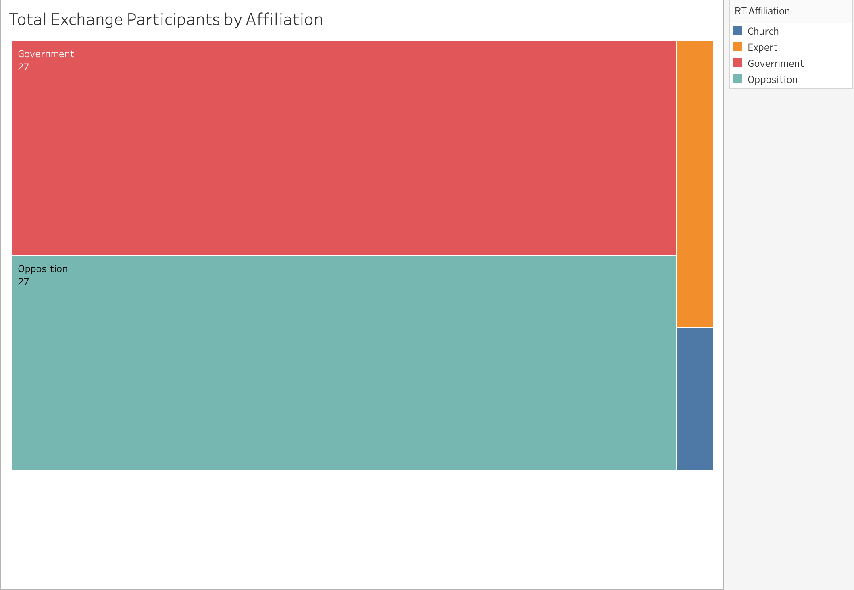
Insight 1: Pathways for Influence Exist

Slide 25
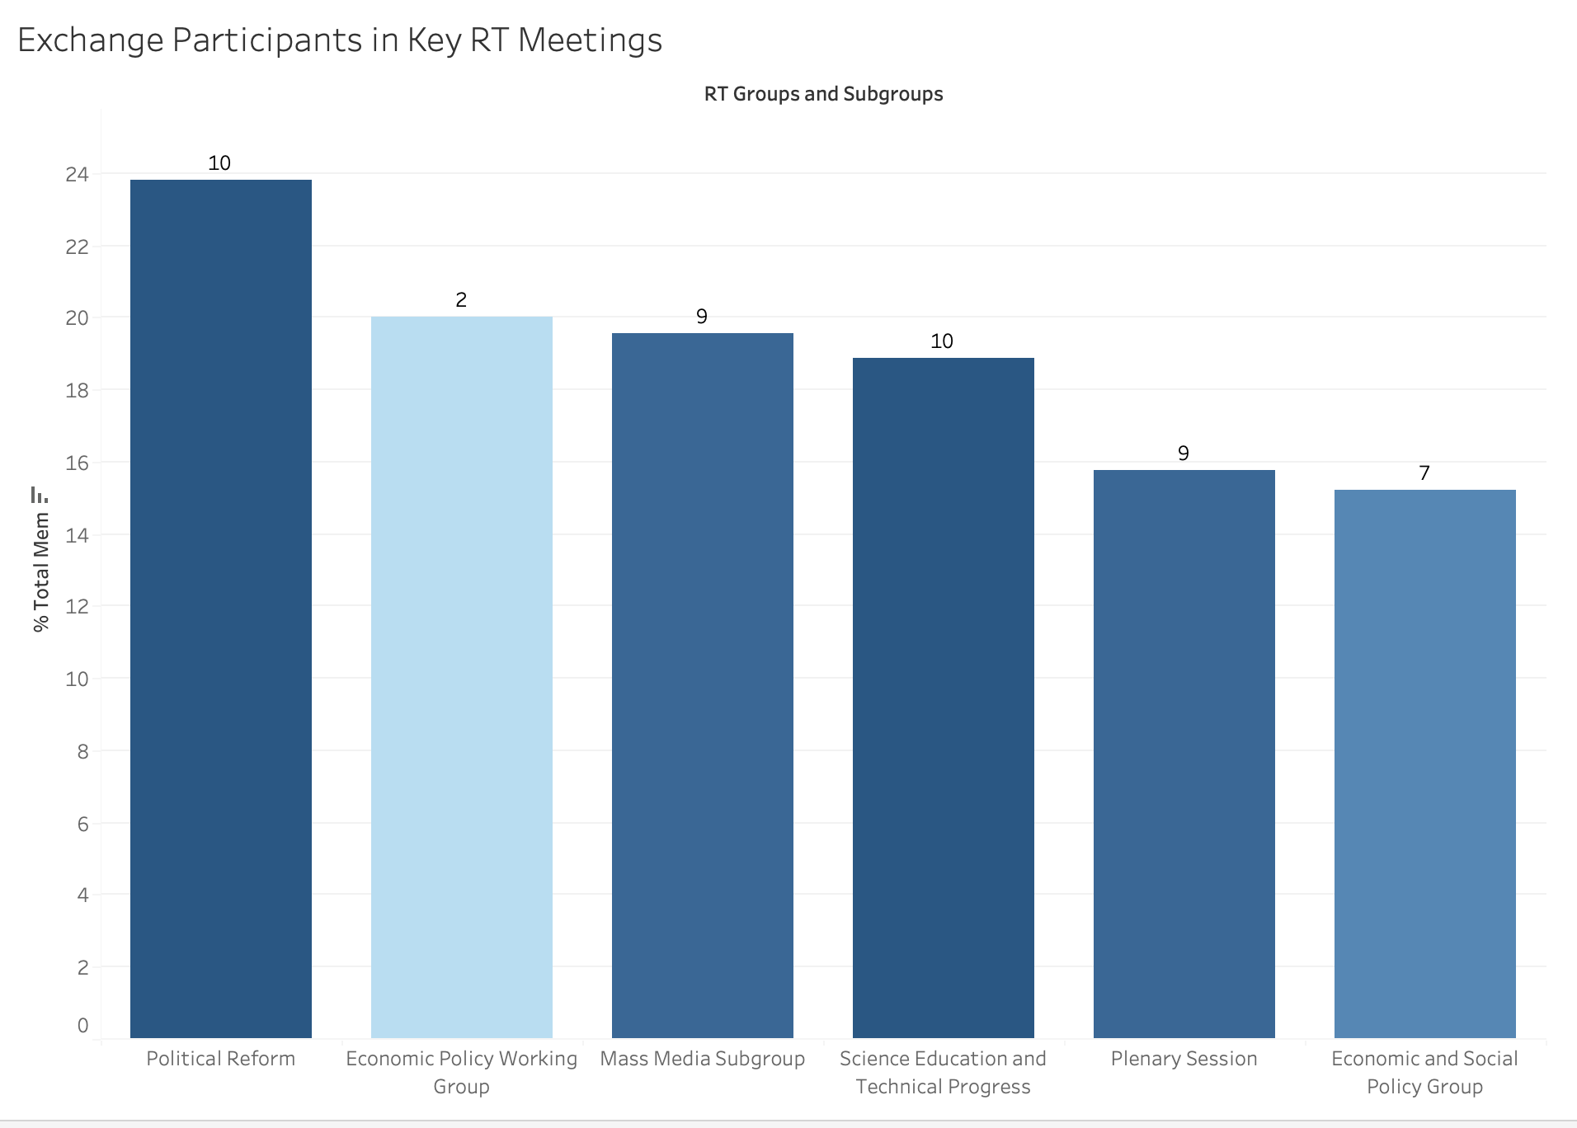
Insight 1: Pathways for Influence Exist
Notes:
Both Chairs of Political Group were Exchange participants (Geremek and Reykowski)

Slide 26

Insight 2: Exchange Participation DOES NOT Equal Opposition
Opposition: 27/196 13.78%
Government: 27/320 8.4%
Expert:
2/47 4.6%
Church/Observer:
1/4 25%
Notes:
No statistical significance in the differences here.

Slide 27
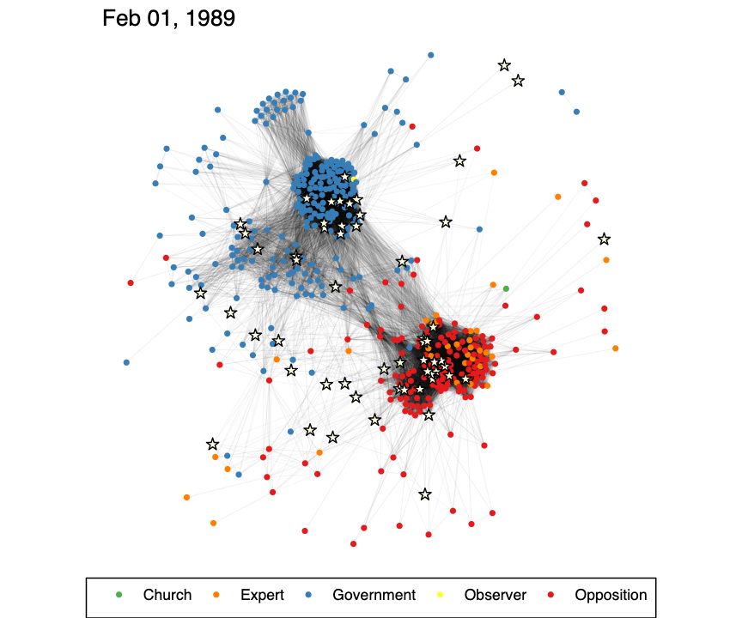
Insight 3: Participation Does NOT EQUAL Positional Moderation
Notes:
My hypothesis does not seem to hold in any simple form.

Slide 28
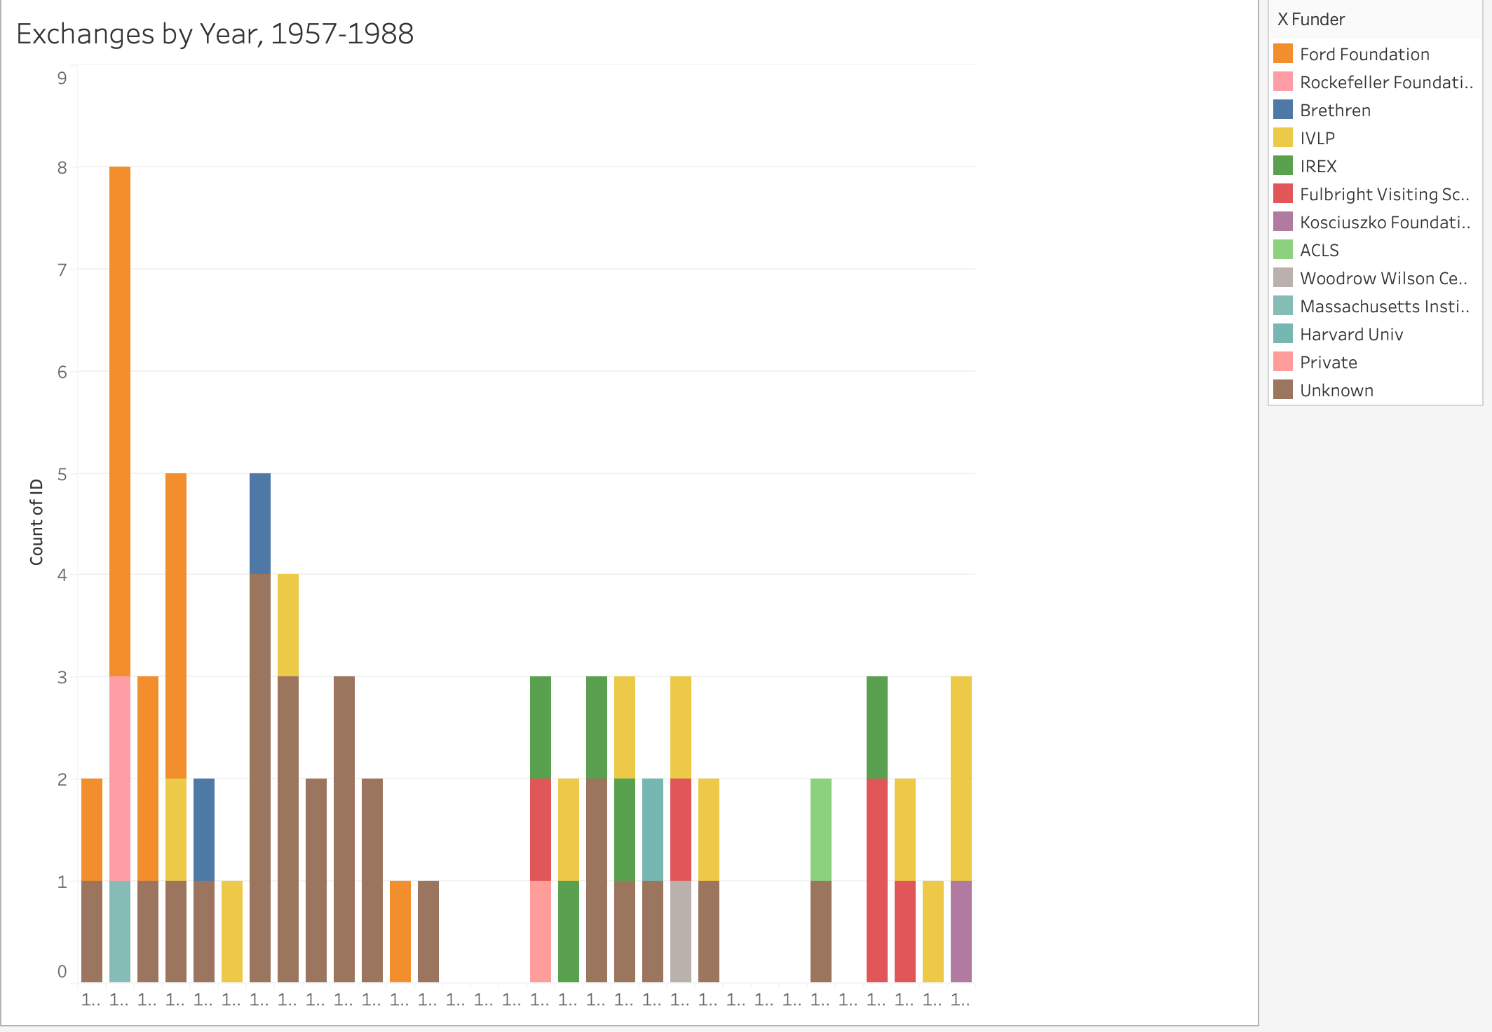
Insight 4: Late 1950s and early 1960s Exchanges mattered
Continued focus on Ford Foundation program

Slide 29
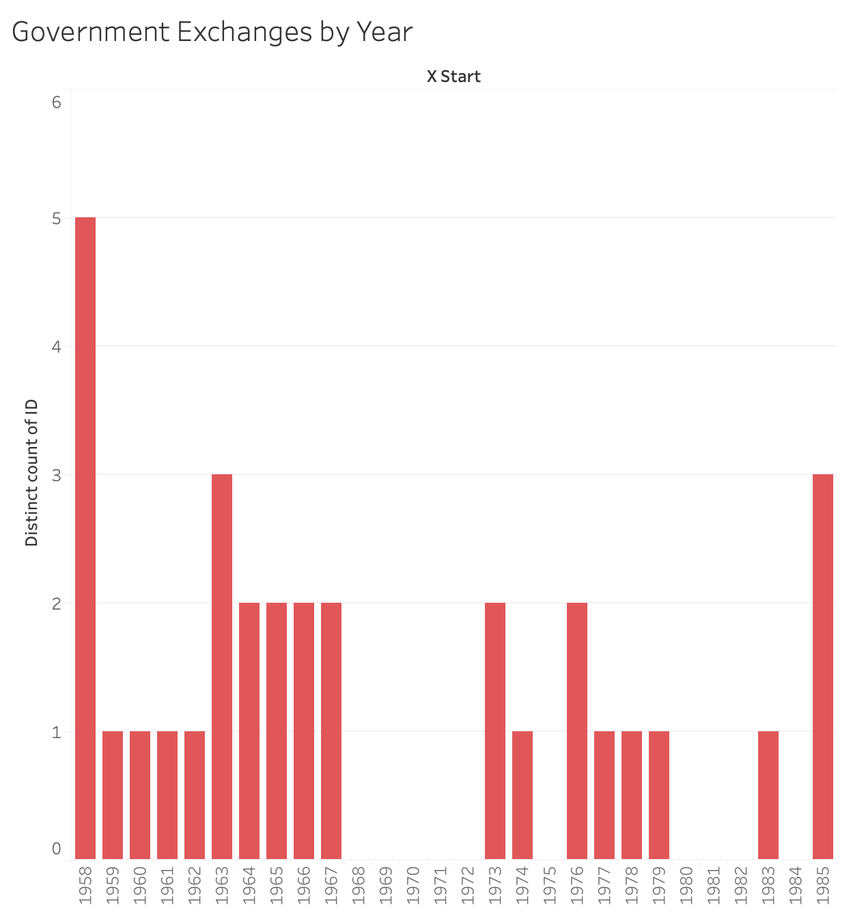
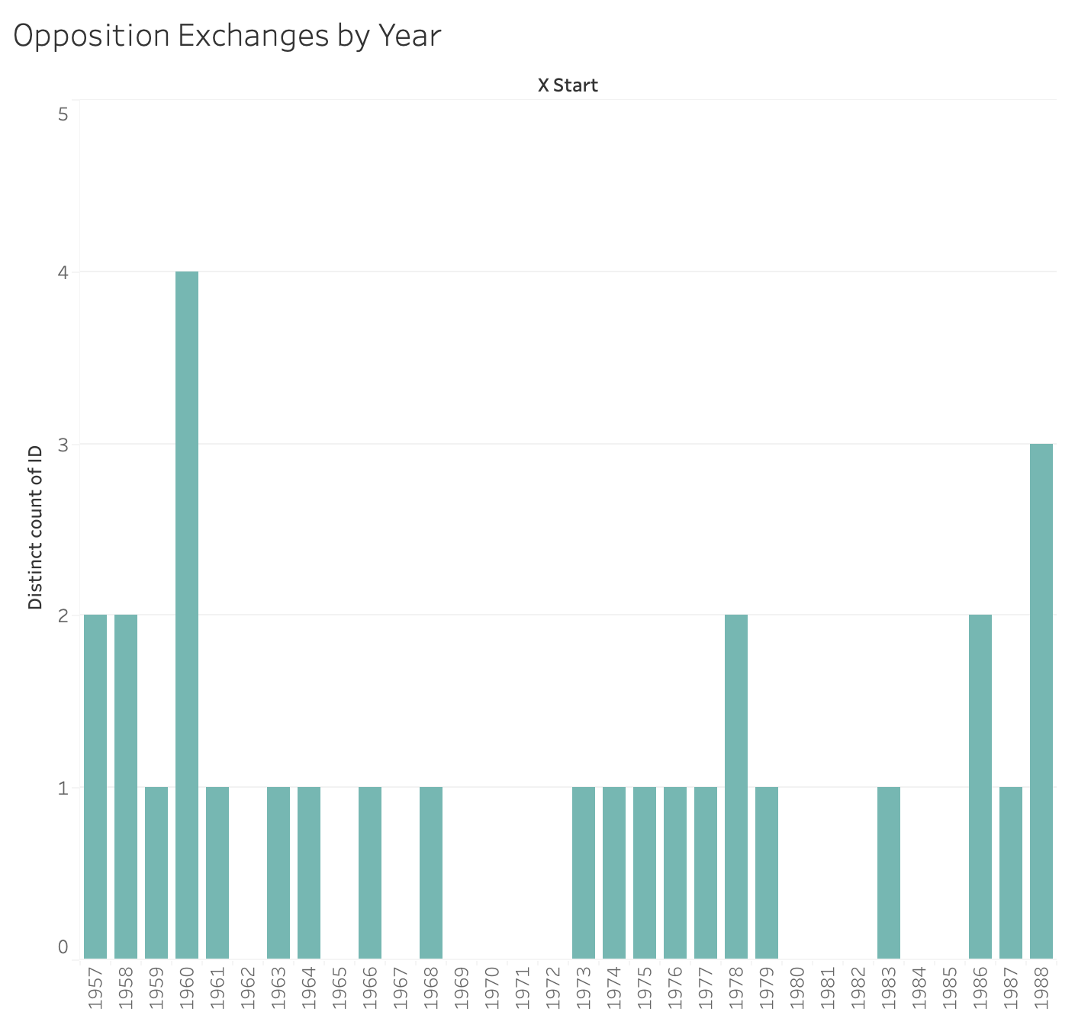
Insight 4: Late 1950s and early 1960s Exchanges mattered

Slide 30
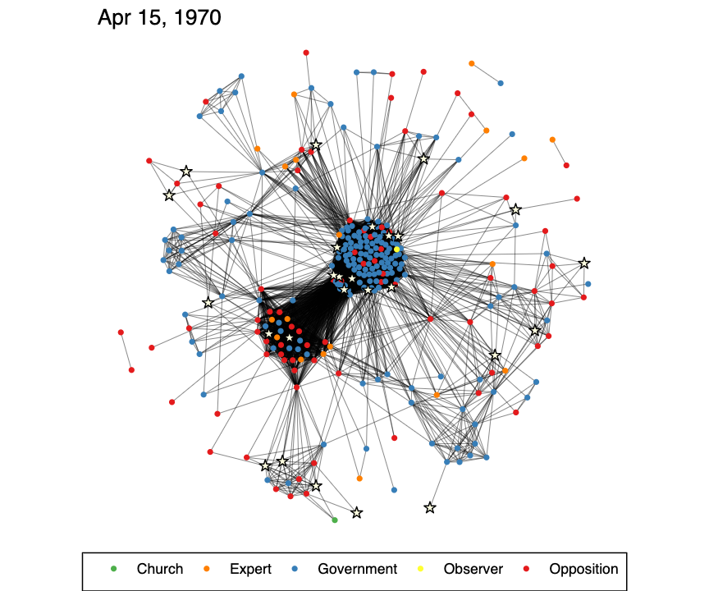
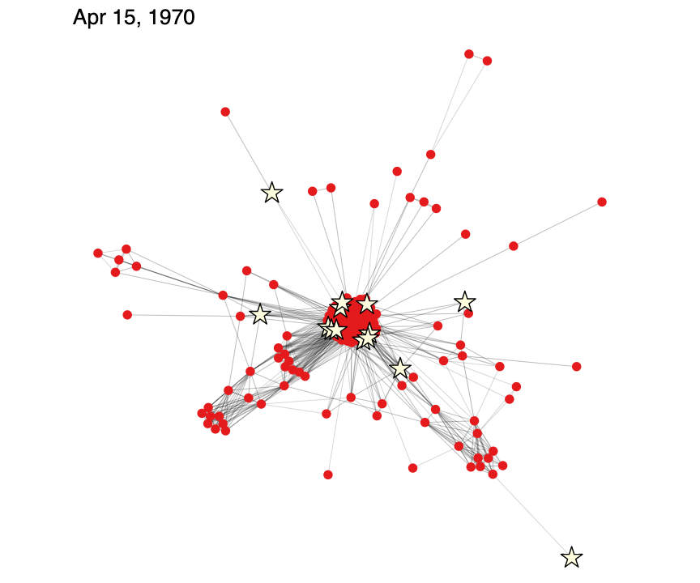
New Questions for Traditional historical Analysis
Is the cluster of exchange participants in the PZPR core a cluster of reformers?
How did exchanges effect their views?

Slide 31
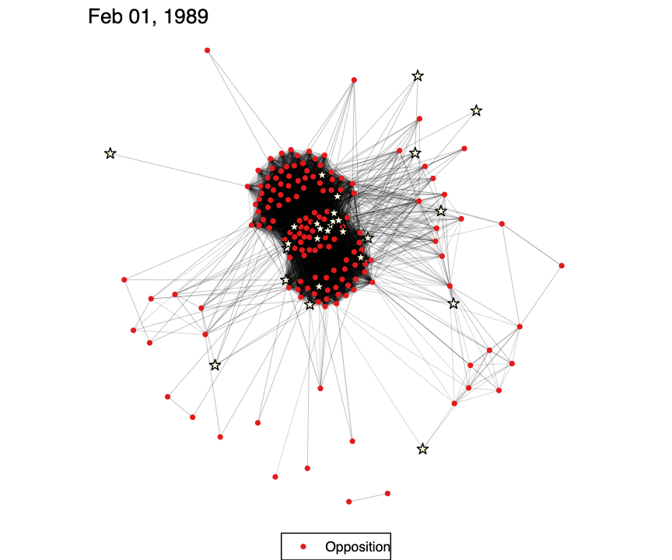
New Questions for Traditional historical Analysis
Is the cluster of exchange participants in the Opposition core a cluster of reformers?
How did exchanges effect their views?

Slide 32
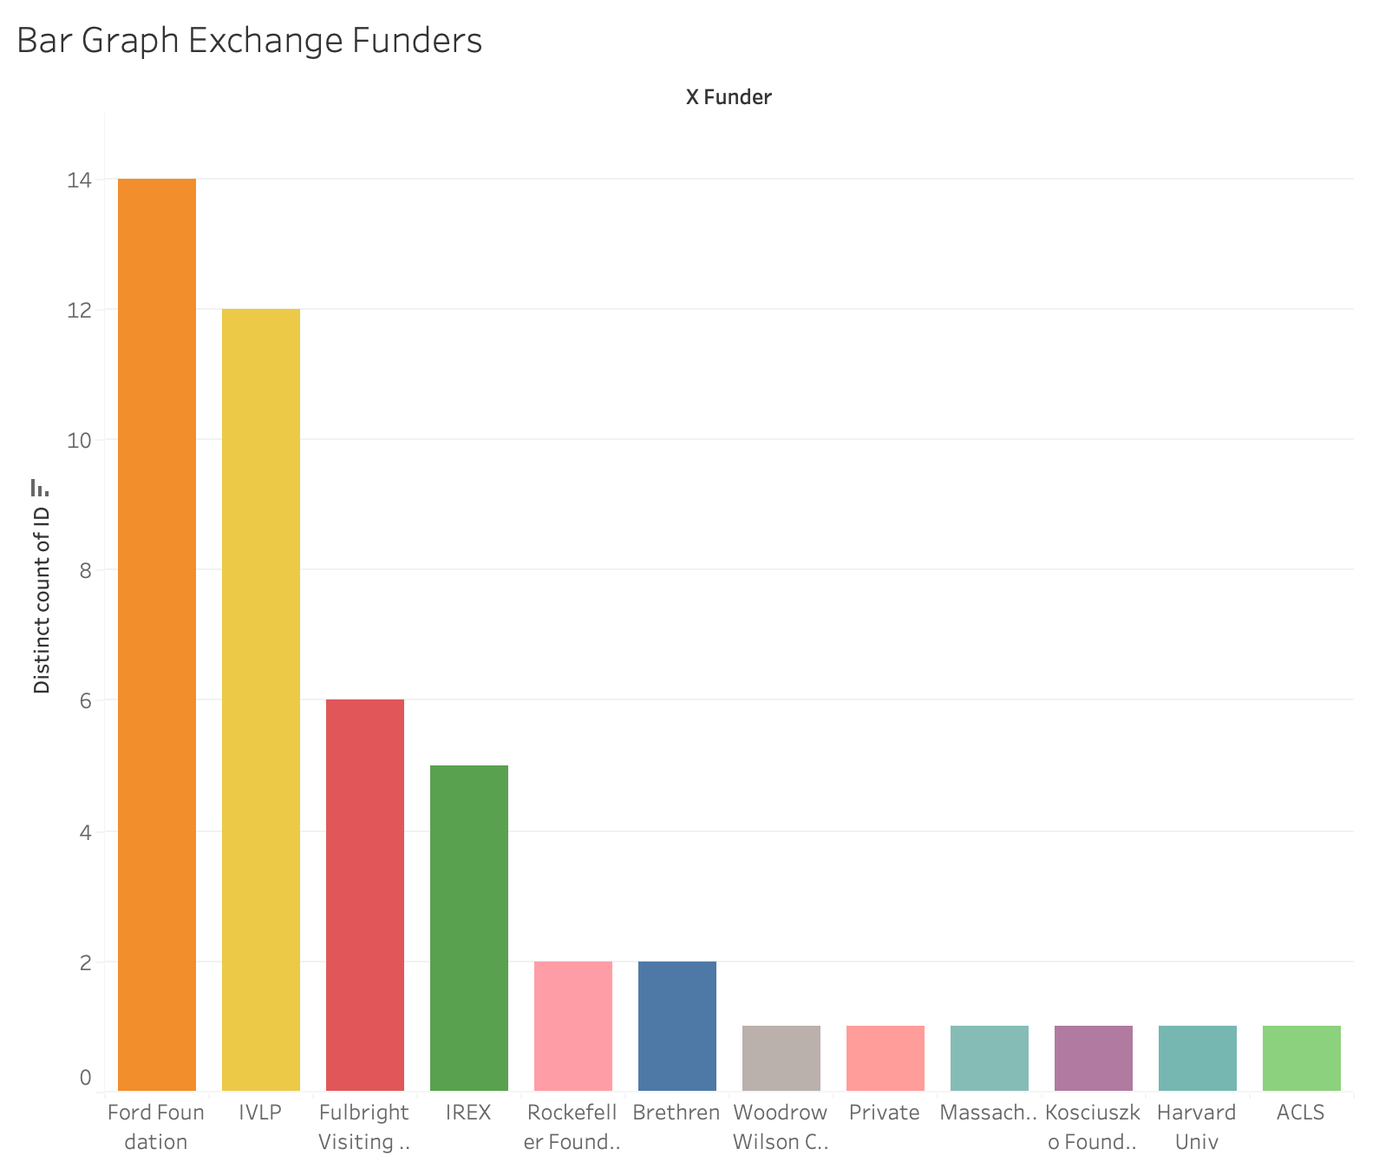
New Questions: Why FoRD and IVLP?
Humanists, Journalists, and Social Scientists vs. Medical and Hard Sciences?
Role of Leadership?
Freedom of action?
Policy applications for today?

Slide 33
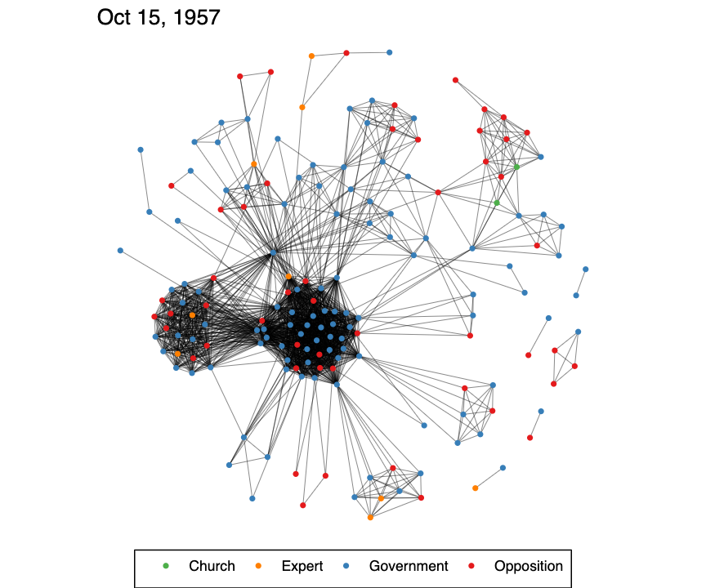
New Questions: How to Improve the Shiny App?
Add, correct, modify, and expand the dataset
Your own questions

Slide 34
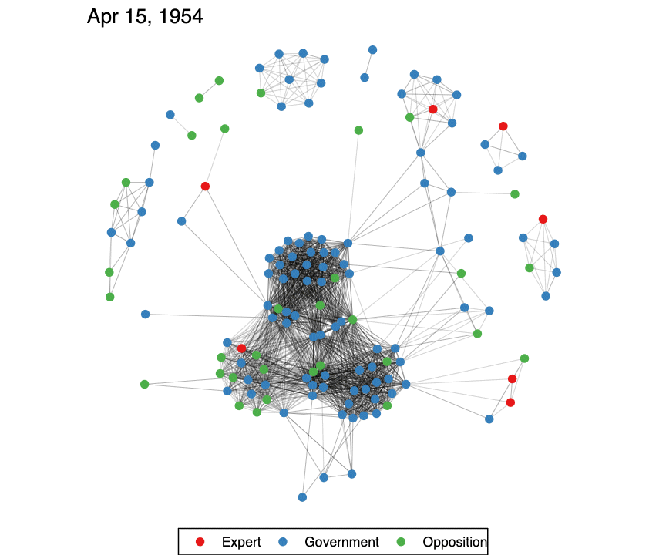
COMMENTS AND QUESTIONS?
*This work has been generously funded by:
Smith Richardson Foundation
Polish-American Fulbright Committee
Cal Poly
Rockefeller Archives Center

